Slide 1
HTML Helpers
Date

Slide 2
Types of HTML Helpers
Inline HTML Helpers
Built-In HTML Helpers
Standard
Strongly Typed
Templated
Custom HTML Helpers

Slide 3
Basic Helper
They are created using the @helper syntax in Razor
@helper ListingItems(string[] items)
{
<ol>
@foreach (string item in items)
{
<li>@item</li>
}
</ol>
}

Slide 4
Standard HTML Helpers
BeginForm
@using (Html.BeginForm("Manage", "Account")) {…
Used to create a Form
When used without parameters it represents the post action
ValidationSummary
@Html.ValidationSummary()
Provides an unordered list of validation errors in the page

Slide 5
Standard HTML Helpers
TextBox
@Html.TextBox("Textbox1", "val")
Output: <input id="Textbox1" name="Textbox1" type="text" value="val" />
TextArea
@Html.TextArea("Textarea1", "val", 5, 15, null)
Output: <textarea cols="15" id="Textarea1" name="Textarea1" rows="5">val</textarea>
Password
@Html.Password("Password1", "val")
Output: <input id="Password1" name="Password1" type="password" value="val" />

Slide 6
Standard HTML Helpers
Hidden Field
@Html.Hidden("Hidden1", "val")
Output: <input id="Hidden1" name="Hidden1" type="hidden" value="val" />
CheckBox
@Html.CheckBox("Checkbox1", false)
Output:< input id="Checkbox1" name="Checkbox1" type="checkbox" value="true" />< input name="myCheckbox" type="hidden" value="false" />
RadioButton
@Html.RadioButton("Radiobutton1", "val", true)
Output: <input checked="checked" id="Radiobutton1" name="Radiobutton1" type="radio" value="val" />

Slide 7
Standard HTML Helpers
Drop-down list
@Html.DropDownList (“DropDownList1”, new SelectList(new [] {"Male", "Female"}))
Output:< select id="DropDownList1" name="DropDownList1"><
option>M</option>< option>F</option>< /select>
Multiple-select
Html.ListBox(“ListBox1”, new MultiSelectList(new [] {"Cricket", "Chess"})) Output:< select id="ListBox1" multiple="multiple" name="ListBox1">
< option>Cricket</option>< option>Chess</option>< /select>

Slide 8
Strongly Typed HTML Helpers
These helpers are created based on Model properties
They can work on lambda expressions
The model object is passed as an object from which are selected fields or properties to be set to id, name and value attributes

Slide 9
Strongly Typed HTML Helpers
TextBox
@Html.TextBoxFor(m=>m.Name)
Output: <input id="Name" name="Name" type="text" value="Name-val" />
TextArea
@Html.TextArea(m=>m.Address , 5, 15, new{}))
Output: <textarea cols="15" id="Address" name=" Address " rows="5">Addressvalue</textarea>
Password
@Html.PasswordFor(m=>m.Password)
Output: <input id="Password" name="Password" type="password"/>

Slide 10
Strongly Typed HTML Helpers
Hidden Field
@Html.HiddenFor(m=>m.UserId) Output:
<input id=" UserId" name=" UserId" type="hidden" value="UserId-val" />
CheckBox
@Html.CheckBoxFor(m=>m.IsApproved)
Output:< input id="Checkbox1" name="Checkbox1" type="checkbox" value="true" />< input name="myCheckbox" type="hidden" value="false" />

Slide 11
Strongly Typed HTML Helpers
RadioButton
@Html.RadioButtonFor(m=>m.IsApproved, "val")
Output: <input checked="checked" id="Radiobutton1" name="Radiobutton1" type="radio" value="val" />
Drop-down list
@Html.DropDownListFor(m => m.Gender, new SelectList(new [] {"Male", "Female"}))
Output:< select id="Gender" name="Gender">< option>Male</option>< option>Female</option>< /select>

Slide 12
Strongly Typed HTML Helpers
Multiple-select
Html.ListBoxFor(m => m.Hobbies, new MultiSelectList(new [] {"Cricket", "Chess"}))
Output:< select id="Hobbies" multiple="multiple" name="Hobbies">< option>Cricket</option>< option>Chess</option>< /select>

Slide 13
Templated HTML Helpers
These helpers figure out the HTML elements needed based on the properties of the model
The model properties need to be set up with DataTypes and DataAnnotations for this helper to work effectively

Slide 14
Templated HTML Helpers
Display
Renders a read-only view of the specified model property and selects an appropriate HTML element based on property’s data type and metadata. Html.Display("Name")
DisplayFor
Strongly typed version of the previous helper Html.DisplayFor(m => m. Name)

Slide 15
Templated HTML Helpers
Editor
Renders an editor for the specified model property and selects an appropriate HTML element based on property’s data type and metadata. Html.Editor("Name")
EditorFor
Strongly typed version of the previous helper Html.EditorFor(m => m. Name)

Slide 16
Custom Html Helpers
Create your own custom helper methods by creating an extension method to the HtmlHelper class
Declarative Helpers
This helper type is created using the declaration syntax helper in .cshtml file (or .vbhtml). Same as you design a page to the Razor view engine

Slide 17
Controllers and Actions
Date

Slide 18
IController, ControllerBase, and Controller
Icontroller is an interface defines the methods that are required for a controller.
ControllerBase is a base class for an MVC controller without view support
Controllers are responsible for controlling the flow of the application execution

Slide 19
Defining Actions
Icontroller is an interface defines the methods that are required for a controller.
ControllerBase is a base class for an MVC controller without view support
Controllers are responsible for controlling the flow of the application execution

Slide 20
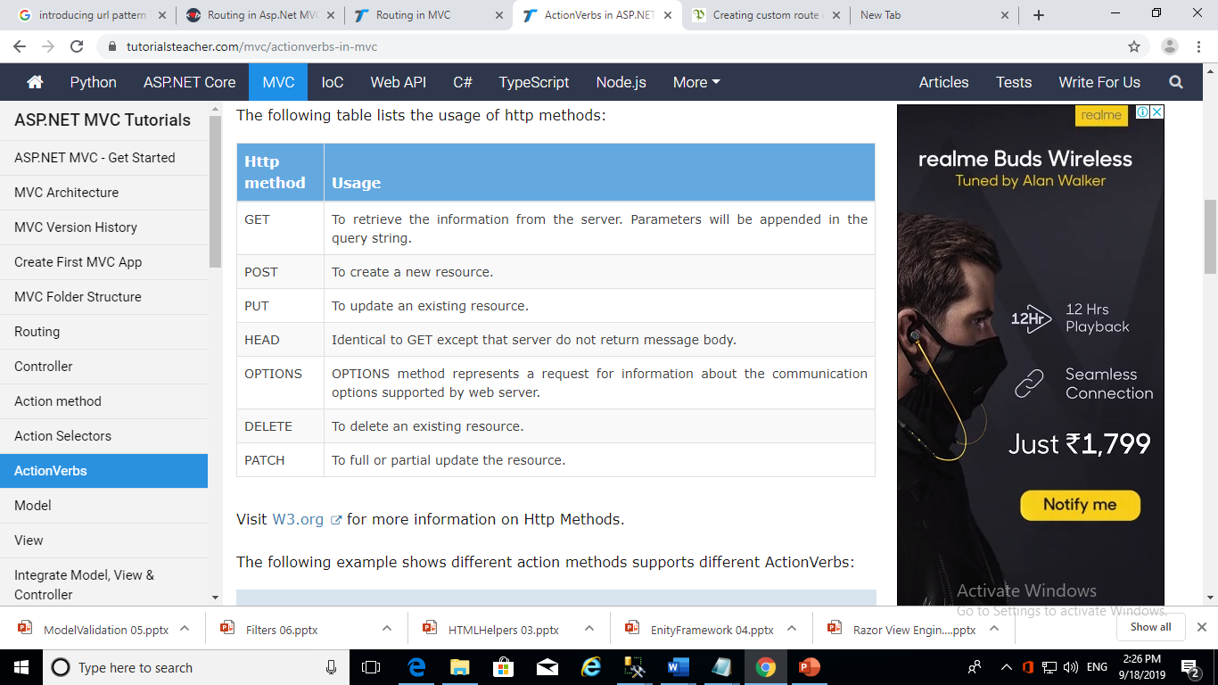
HTTP Verbs

Slide 21
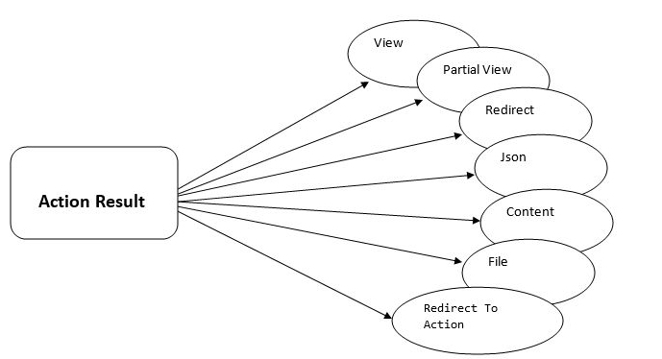
Returning Data with ActionResult

Slide 22
Parameters and the Model Binder
Model binding is a mechanism ASP.NET MVC uses to create parameter objects defined in controller action methods. The parameters can be of any type, from simple to complex ones. It simplifies working with data sent by the browser because data is automatically assigned to the specified model

